Slide 1
Data Analysis Report

Slide 2
Price Prediction using Linear Regression, Decision Trees and Random Forests
First, I downloaded the data file, titled car.data, from [https://code.datasciencedojo.com/datasciencedojo/datasets/tree/master/Car%20Evaluation].
I wrote a python script titled multiunitregression.py to process the data and apply 3 predictive models on the buying price, employing Linear Regression, Desision Trees and Random Forests.
The car.data file came without headers, so I wrote function save_file_with_headers to add the headers described in the above url and convert the file to csv, having the car.data.csv file as output.

Slide 3
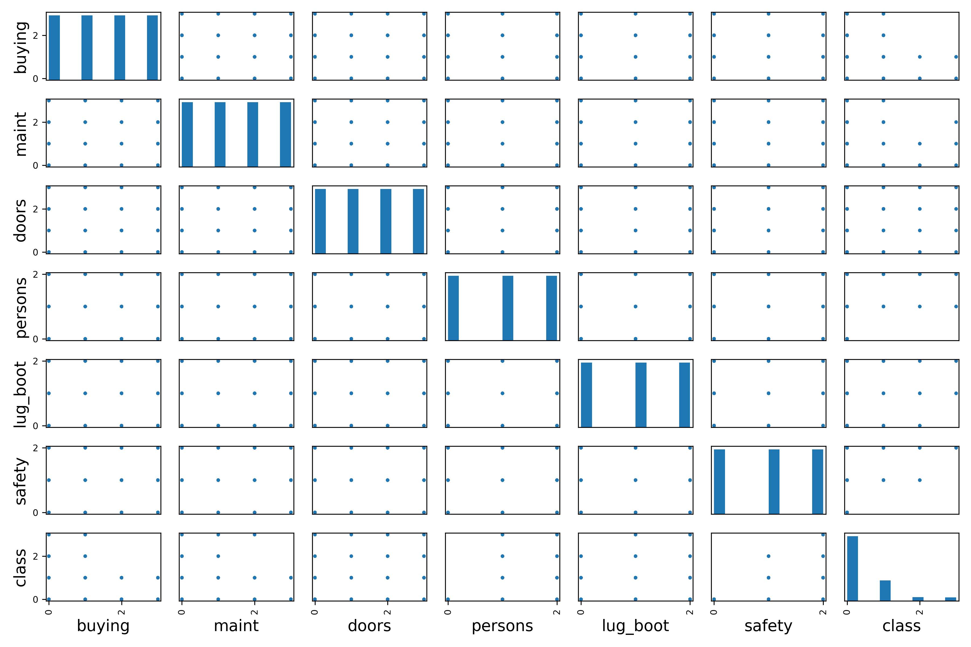
Price Prediction using Linear Regression, Decision Trees and Random Forests
I wrote function ordinal_data_regression to process the data and perform the prediction task.
Given the fact that the attribute data were qualitative, but ordinal, I proceeded to encode each attribute column, from lowest to highest quality, starting from 0.
I checked for attribute correlation, which could be useful in using stratified sampling, to appropriately split the dataset to a training and testing set.
I then trained the Linear Regression, Decision Tree and Random Forest models and tested them on the test set (20% of the entire dataset).

Slide 4
Price Prediction using Linear Regression, Decision Trees and Random Forests
For Linear Regression, RMSE_train_set > RMSE_test_set, we can conclude that there is a very slight underfitting of the data.
For Decision Tree Regressor, RMSE_train_set < RMSE_test_set, we can conclude that there is overfitting of the data.
For Random Forest Regressor, RMSE_train_set < RMSE_test_set, we can conclude that there is some overfitting of the data.
Finally, we test each predictive model on the client’s request (since we do not know the capacity, we test for all three available categories).
Results for Linear Regression seem to indicate medium buying price for the car, the higher the car capacity.
It should be noted that, given the fact that the desired output is a label, not a quantity, multiclass classification employing approaches such as Random Forest Classifier would be more appropriate for this particular dataset.
A new script titled *multiclassification.py* has been written for this purpose.
Results show that a low buying price is predicted for all capacities, which coincides with the result of the Decision Tree and Random Forest Regression.

